Slide 1
WHY FERTILITY
BENEFITS MATTERS
A benefits advisor toolkit
April 2025
The Healthcare business of Merck KGaA, Darmstadt, Germany operates as EMD Serono in the U.S. and Canada

Slide 2
WHAT WE WILL COVER
1
Who needs fertility benefits
Costs of fertility treatment and family building
Public and private coverage
Why fertility benefits matter
Parameters and best practices for
cost effective benefits
2
3
4
5
Notes:
Introductions.
Despite a big increase in awareness, infertility remains a taboo topic. A topic that comes with secrecy, shame, hurt but it shouldn’t because I bet all of us here in this room know someone, or are someone, who has faced this challenge.
This deck is meant to be an educational overview of why fertility benefits matter. And why you and your clients should be considering them as part of their benefit mix.
We will cover:
Who needs fertility benefits
Costs of fertility treatment and family building
Public and private coverage
Why fertility benefits matters
Parameters and best practices for cost effective benefits

Slide 3
FERTILITY BENEFITS ARE
LIFE CHANGING FOR EMPLOYEES
While few need it, those who have it are grateful. This additional support can be the difference between them having a child and not.
A benefit employees will never forget.
Notes:
While few need it, those who have it are grateful. This additional support can be the difference between having a child and not. A benefit employees will never forget.
You can be a driver for this meaningful change.
Here’s a short video of how one employee advocated for fertility benefits and what it meant to her.
LINK FOR VIDEO – DOWNLOAD FILE FROM HERE - https://drive.google.com/drive/folders/1a8mY-M5LQnhEz-Pcc10FDgixE8tTo2Re – Fertility Matters-Interview02.mp4

Slide 4
WHO NEEDS FERTILITY BENEFITS?
Top reasons for
IVF Treatment²
25%
Male factor infertility
Single people
Protect against aging
22%
2SLGBTQIA+
People who need
fertility preservation
Unexplained infertility
21%
Recurrent pregnancy loss
before medical treatment
in transgender people
Diminished ovarian reserve
18%
Patients who carry
genetic conditions
1 in 6
Advanced female age
14%
People of reproductive age
experience infertility
Other
1 World Health Organization
2 Canadian Artificial Reproductive Technologies
Register (CARTR) 2024
Notes:
According to the World Health Organization, infertility is a disease of the male or female reproductive system defined by the failure to achieve a pregnancy after 12 months or more of regular unprotected sexual intercourse.
The stats tell you 1 in 6 people of reproductive age will experience infertility, but there are many ways to make a family and who need help: single people, 2SLGBTQIA community, those facing recurrent pregnancy loss, people with genetic conditions, and people who want to or need to protect their fertility.
In vitro fertilization or IVF is one of the most common treatments used for infertility here’s the top five reasons people seek support – most are shocked to learn the top reason is male factor infertility – particularly when so much focus is placed on women.

Slide 5
CREATING A FAMILY
IS TIME CONSUMING
Fertility treatments
are highly demanding
Time-consuming
Repetitive
Involve frequent monitoring
Medically grueling
Include many providers
Notes:
Fertility treatments are highly demanding mentally, physically, financially and they are very time-consuming.
Treatments are repetitive and typically tied a person’s menstrual cycle (which is not predictable). It involves frequent trips to your clinic for monitoring – sometimes every day or every other day.
It is medically grueling with regular bloodwork, transvaginal ultrasounds, needles and other medications that disrupt one’s body.
And can cover multiple providers including naturopaths, acupuncture, OBGYN, and more adding to fertility clinic and medical appointments.

Slide 6
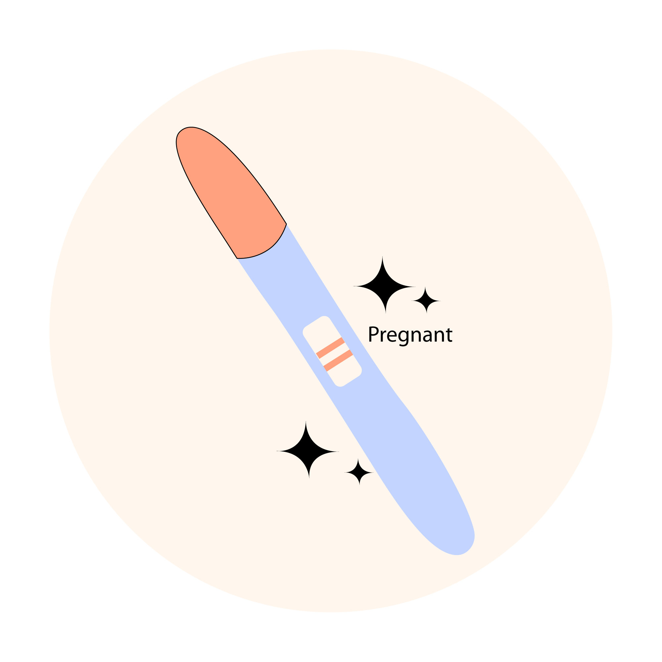
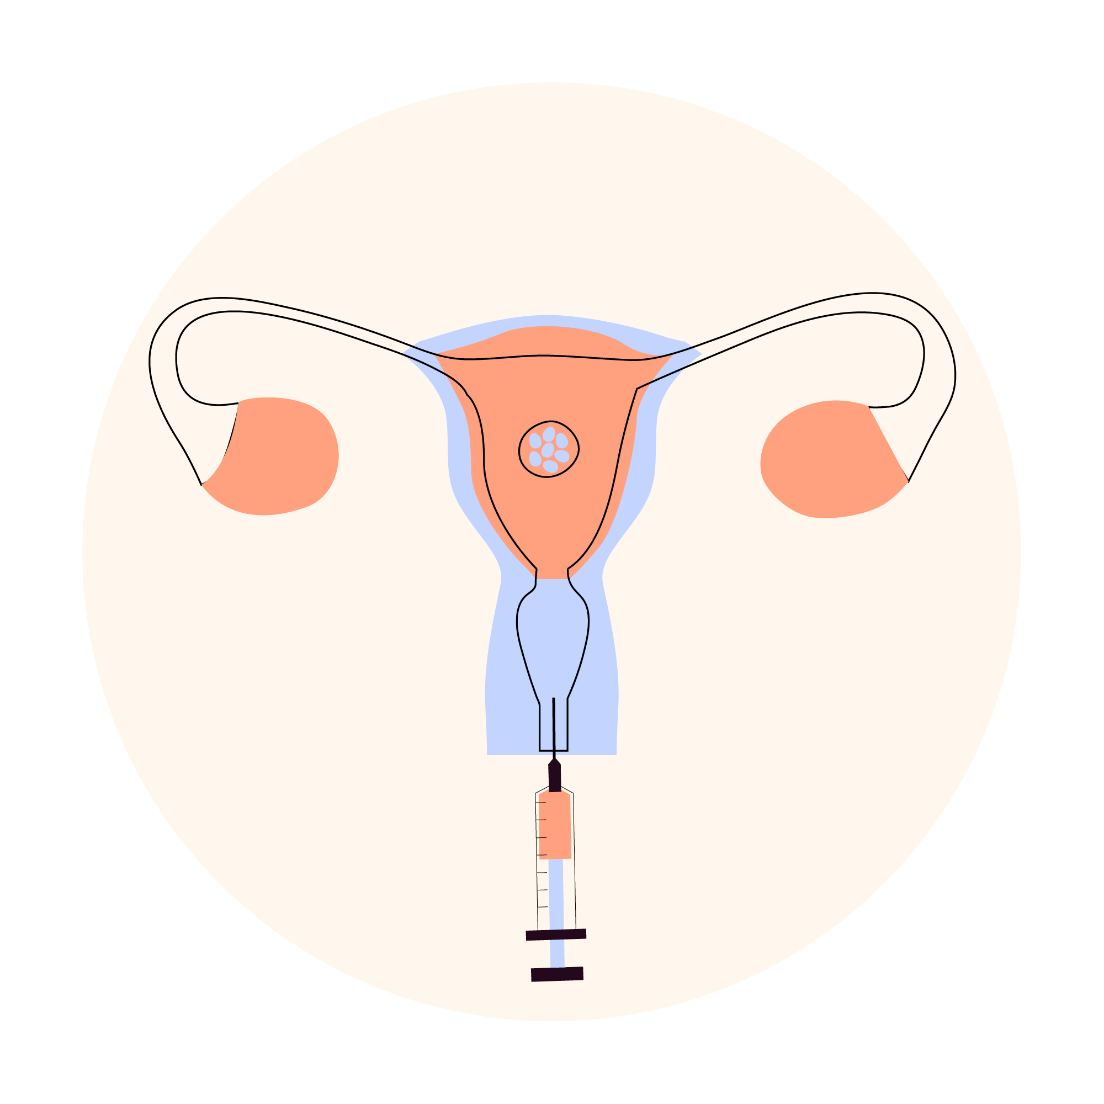
IT TYPICALLY TAKES MORE THAN ONE TRY
Not all embryos implant
Not all eggs fertilize
About half of embryos that successfully implant into the uterus initiate a pregnancy.
1
2
3
4
5
6
Ovarian
stimulation
Egg retrieval &
sperm collection
Fertilization
Embryo culture
Embryo transfer
Pregnancy
Many eggs fertilize but do not continue to grow into an embryo
Transferring one embryo at a time is the best medical practice
During IVF, usually only 70% of mature eggs fertilize, and of those fertilized eggs, only 50% continue to develop into a blastocyst which can be transferred into a uterus.
Historically, due to the costs of fertility treatment, patients would transfer multiple embryos to save costs on repeated embryo transfers. This increases the risk of multiples (aka twins, etc.) and can lead to more medical complications for moms and babies.
1 American society for Reproductive Medicine
Notes:
And typically, the journey is complicated and takes more than one try.
Not every egg will successfully fertilize. Those that do, may not continue to grow to an embryo; not all embryo’s will implant in the uterus to begin a pregnancy and even once implanted, a successful birth is not guaranteed.
This is all to say fertility treatment is daunting and emotionally overwhelming - even when things are going well.

Slide 7
CREATING A FAMILY IS EXPENSIVE
* Does not include the cost of drugs
 | DESCRIPTION | VISITS TO CLINIC DURING CYCLE | APPROXIMATE COST
Cycle monitoring | Occurs during the first half of the menstrual cycle to follow the development of the eggs to help time fertilization. Medications may be used to increase ovulation. | Every 1-3 days for 10-14 days | $500
Intrauterine insemination (IUI) | After cycle monitoring, sperm is injected directly into the uterus. | Every 1-3 days | $650*
In vitro fertilization (IVF): Egg retrieval and embryology | Using cycle monitoring, eggs are surgically removed from the ovaries. Medications are typically used to increase ovulation. Once retrieved, the eggs are fertilized in the lab with sperm. Successful fertilization creates an embryo. | Every 1-3 days for 10-14 days | $8,000*
In vitro fertilization (IVF): Embryo transfer | Viable embryos are surgically placed inside the uterus. Medications are often used to optimize chances of pregnancy. | Monthly or as required | $2,000
IVF drugs | Drugs used to increase success rates. |  | $8,000
Genetic testing | Screening tests that can increase changes for a successful pregnancy with healthy embryos. |  | $4,000
Egg freezing only | IVF retrieval and embryology is completed and either eggs or embryos are frozen for future use. | Every 1-3 days for 10-14 days | $6,500*
Storage fees | Fees to store genetic material (sperm, eggs, or embryos) for future use. |  | $400/year
Gestational surrogacy | Fees include medical screening, IVF and drugs, legal fees, surrogate reimbursements, travel expenses. |  | $60,000
Notes:
Not only is it time consuming – it is expensive.
This chart outlines the average Canadian costs of typical treatments with a description of what they are. For instance, some people are shocked to learn the average cost of one round of IVF in Canada is $20,000 for your treatment and drugs. And most people will require 2-3 rounds for a pregnancy.

Slide 8
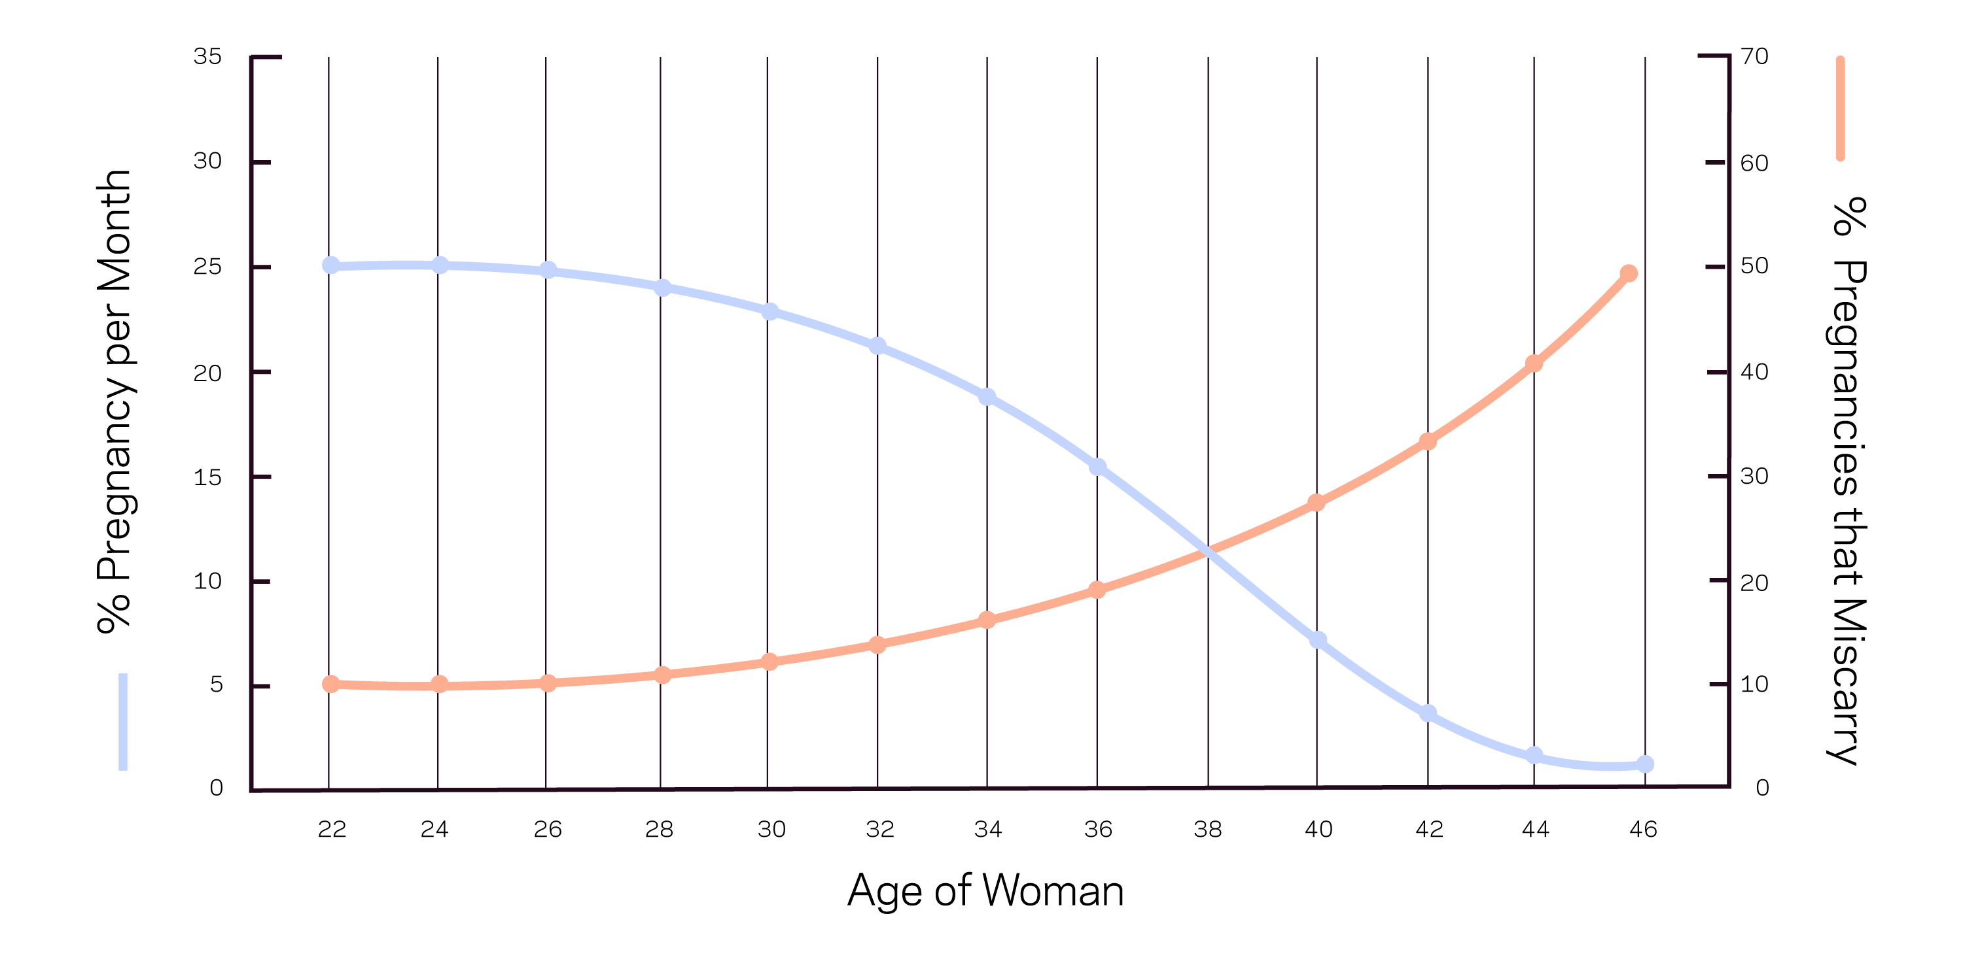
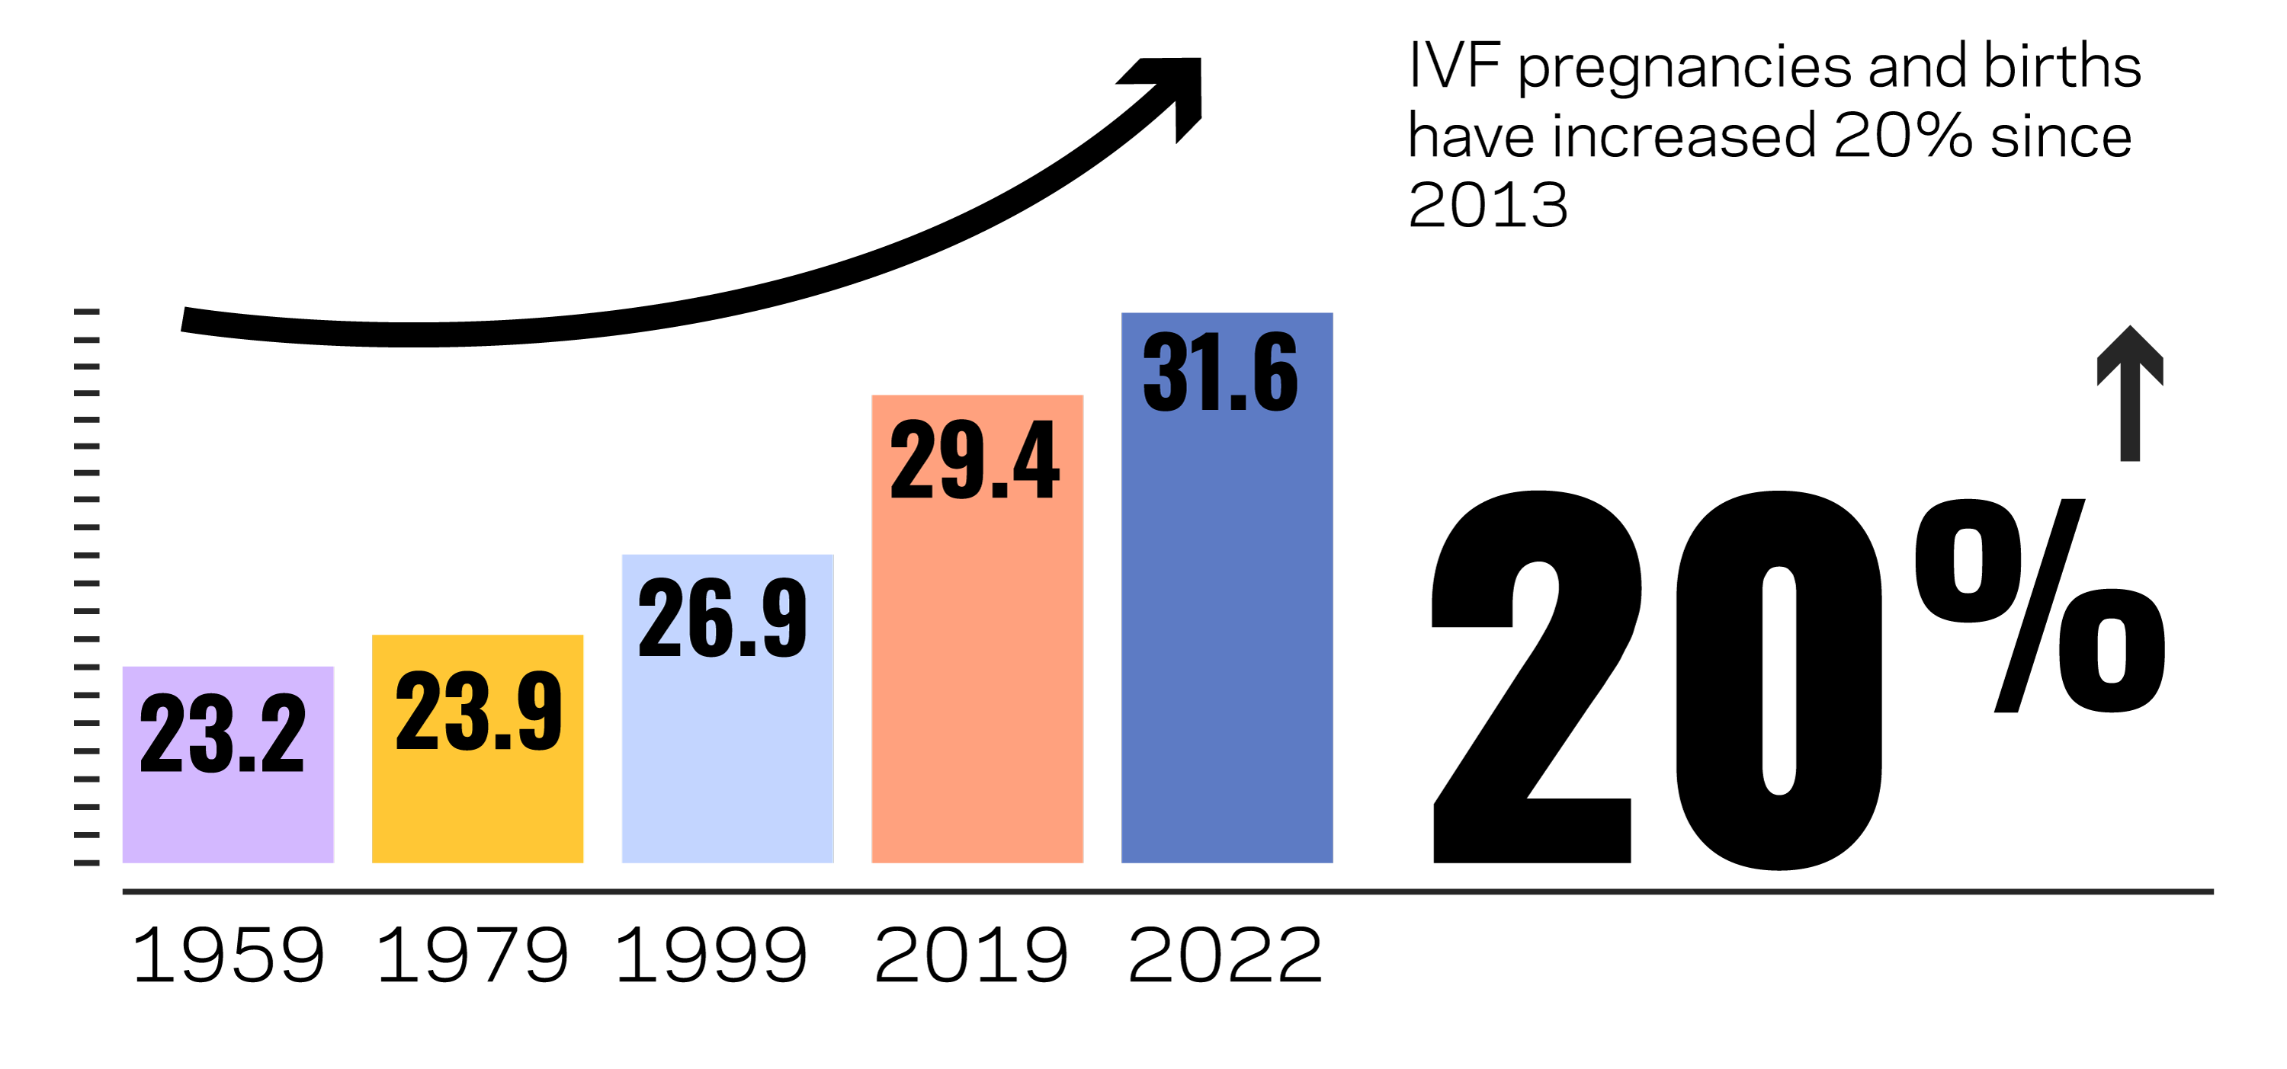
THE NEED FOR FAMILY
BUILDING SUPPORT
IS INCREASING
Canada’s birth rate is at an all time low. Below the birth replenishment rate required to sustain and stabilize the population. This is exacerbated because people are choosing to have families later in life, at a time when conception is harder.
As women age, their ability to conceive declines and miscarriage rates increase
1 Statistics Canada\
2 Canadian Artificial Reproductive Technologies Register (CARTR) 2024
Notes:
And the need for support is increasing.
Canada’s birth rate is at all time low. We are even below the population replacement number.
Over the past five decades, the average of age of mothers has been steadily increasing and is now 31 years old.
This is an additional challenge for women because as they age, their ability to conceive declines, and very quickly after 30.
In addition, as people with uterus’ age, their chance of miscarriage increase posing more risks for moms and babies.
This is why its important to look at options like egg freezing to take some of the pressure off the system.

Slide 9
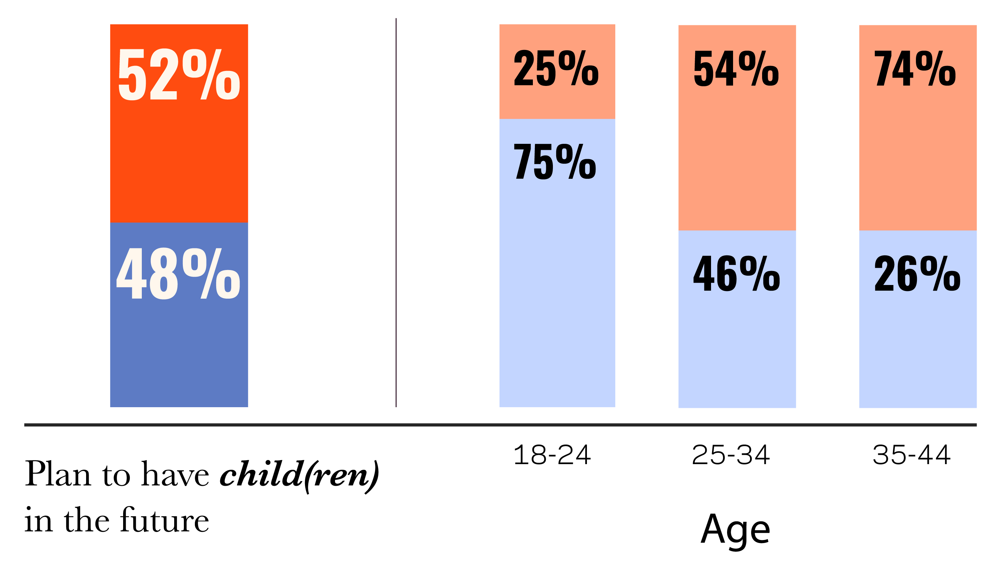
HALF OF THOSE WHO WANT CHILDREN, DELAYED LARGELY DUE TO COST
Half of Canadian adults (18-54) who haven’t had children still want them
1 in 5 (21%) definitely want at least one child
1 in 3 (32%) say maybe
Have you delayed having children longer than you may have wanted ideally because of other aspects of life?
Reasons for delaying:
Uncertainty around finances and job market (41%)
They haven’t found the right partner (40%)
Cost of childcare (33%)
Housing affordability crisis (31%)
Yes, I have delayed longer
than I may have wanted ideally
No, going to have them
as planned/ when I want
25% say they decided not to have kids because the costs were too daunting
https://angusreid.org/birth-rate-crisis-child-care/
Notes:
In fact, a recent survey of Canadians found half of those who want children are delaying largely due to cost.
And a quarter of Canadians decided not to have kids at all because the costs were too daunting.

Slide 10
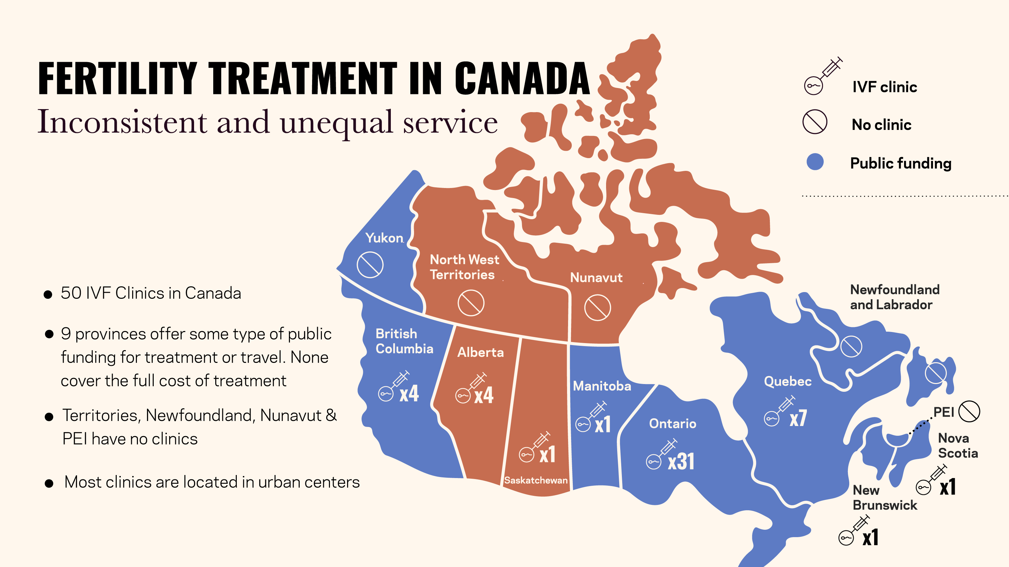
FERTILITY TREATMENT IN CANADA
IVF clinic
Inconsistent and unequal service
No clinic
Public funding
Yukon
50 IVF Clinics in Canada
9 provinces offer some type of public
funding for treatment or travel. None
cover the full cost of treatment
Territories, Newfoundland, Nunavut & PEI have no clinics
Most clinics are located in urban centers
North West Territories
Nunavut
Newfoundland
and Labrador
British Columbia
Alberta
Manitoba
Quebec
x4
x4
x1
x7
PEI
Ontario
x1
Nova Scotia
x31
Saskatchewan
New
Brunswick
x1
x1
Notes:
Part of that cost challenge is fertility treatments are not covered by public healthcare.
Here’s a picture of care in Canada. After a decade of lobbying, today nine provinces provide some type of funding for fertility treatment. This is a big deal considering just five years ago, only half the provinces provided some type of funding for IVF.
But across Canada there are 50 clinics that offer IVF (the most common infertility treatment) And, some provinces and territories (Yukon, Northwest Territories, Nunavut, Newfoundland, Labrador, and PEI) do not offer any services in province so people must travel to out of province for treatment. Adding to financial and mental stress.
In provinces where treatment is available, these clinics are typically only in major urban cities so most people still have to plan for travel time and costs as part of this medical treatment.
The good news is public support continues to increase. In the past year, BC launched a funded program and Ontario and Newfoundland have increased their public funding.
This is where we need more collaboration between private and public payers to support people in Canada.

Slide 11
AT A GLANCE:
PROVINCIAL PUBLIC FUNDING
* Must use private coverage first
**No drug coverage
PROVINCE / TERRITORY | FUNDING
British Columbia | Provides one-time funding up to $19,000 for IVF treatment including drugs
Manitoba | Offers a refundable tax credit equal to 40% of the cost of treatment for a maximum credit of $16,000 per year.*
Ontario | Funding for one IVF cycle, plus an additional cycle if using as a surrogate, IUI, AI, fertility preservation.** Coming 2025 – tax credit for up to 25% of eligible expenses to a maximum of $5,000/year. Details TBC
Quebec | Funding for one IVF cycle, IUI, AI, fertility preservation. Plus, a tax credit of up to $20,000 per year.* Most drugs are also covered under the provincial plan.
New Brunswick | A one time per household reimbursement of 50% of eligible costs to a maximum of $5,000. Announced in 2024 the government plans to cover 1 round of IVF (details tbc).
Saskatchewan | No funding. Coming 2025, one-time refundable annual tax equal to 50% of expenses to a maximum of $10,000.
PROVINCE / TERRITORY | FUNDING
Nova Scotia | Offers refundable tax credit equal to 40% of medical expenses up to a maximum refundable annual tax credit of $8,000 (per couple)*. Includes surrogacy.
Newfoundland and Labrador | Offers up to $20,000 in a refundable tax credit that can be staggered over time. Treatment is not available in province. *
Prince Edward Island | Provides up to $10,000 annually based on family income for up to three years. Treatment is not available in province.*
Yukon | Travel grant only. Covers travel costs up to $174/day. Treatment is not available in province.
Nunavut | No funding. Treatment is not available in province.
Northwest Territories | No funding. Treatment is not available in province.
Alberta | No funding.
Notes:
Here’s a more detailed view of public coverage across Canada.
As you can see every province is different.
Some offer funded cycles (just treatment, no drugs). Other offer tax credits.
Quebec offers the most support at this point with funding for drugs and treatment thanks to RAMQ.
Some provinces also stipulate that private insurance must be used first.

Slide 12
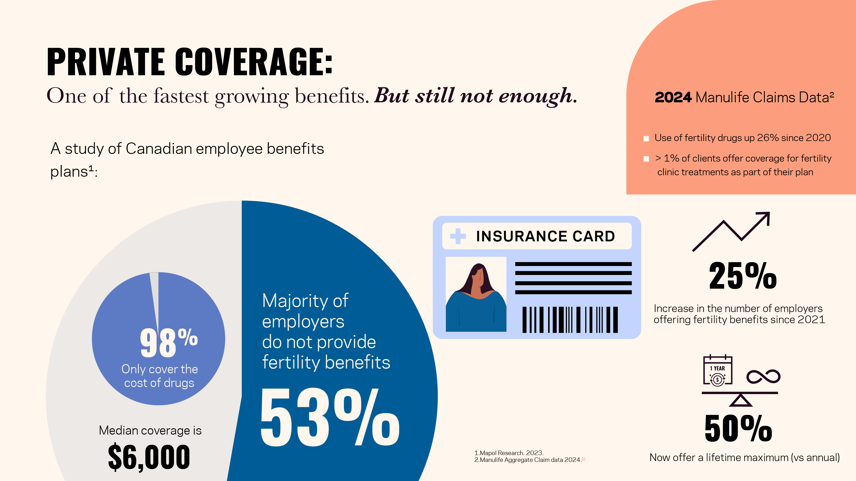
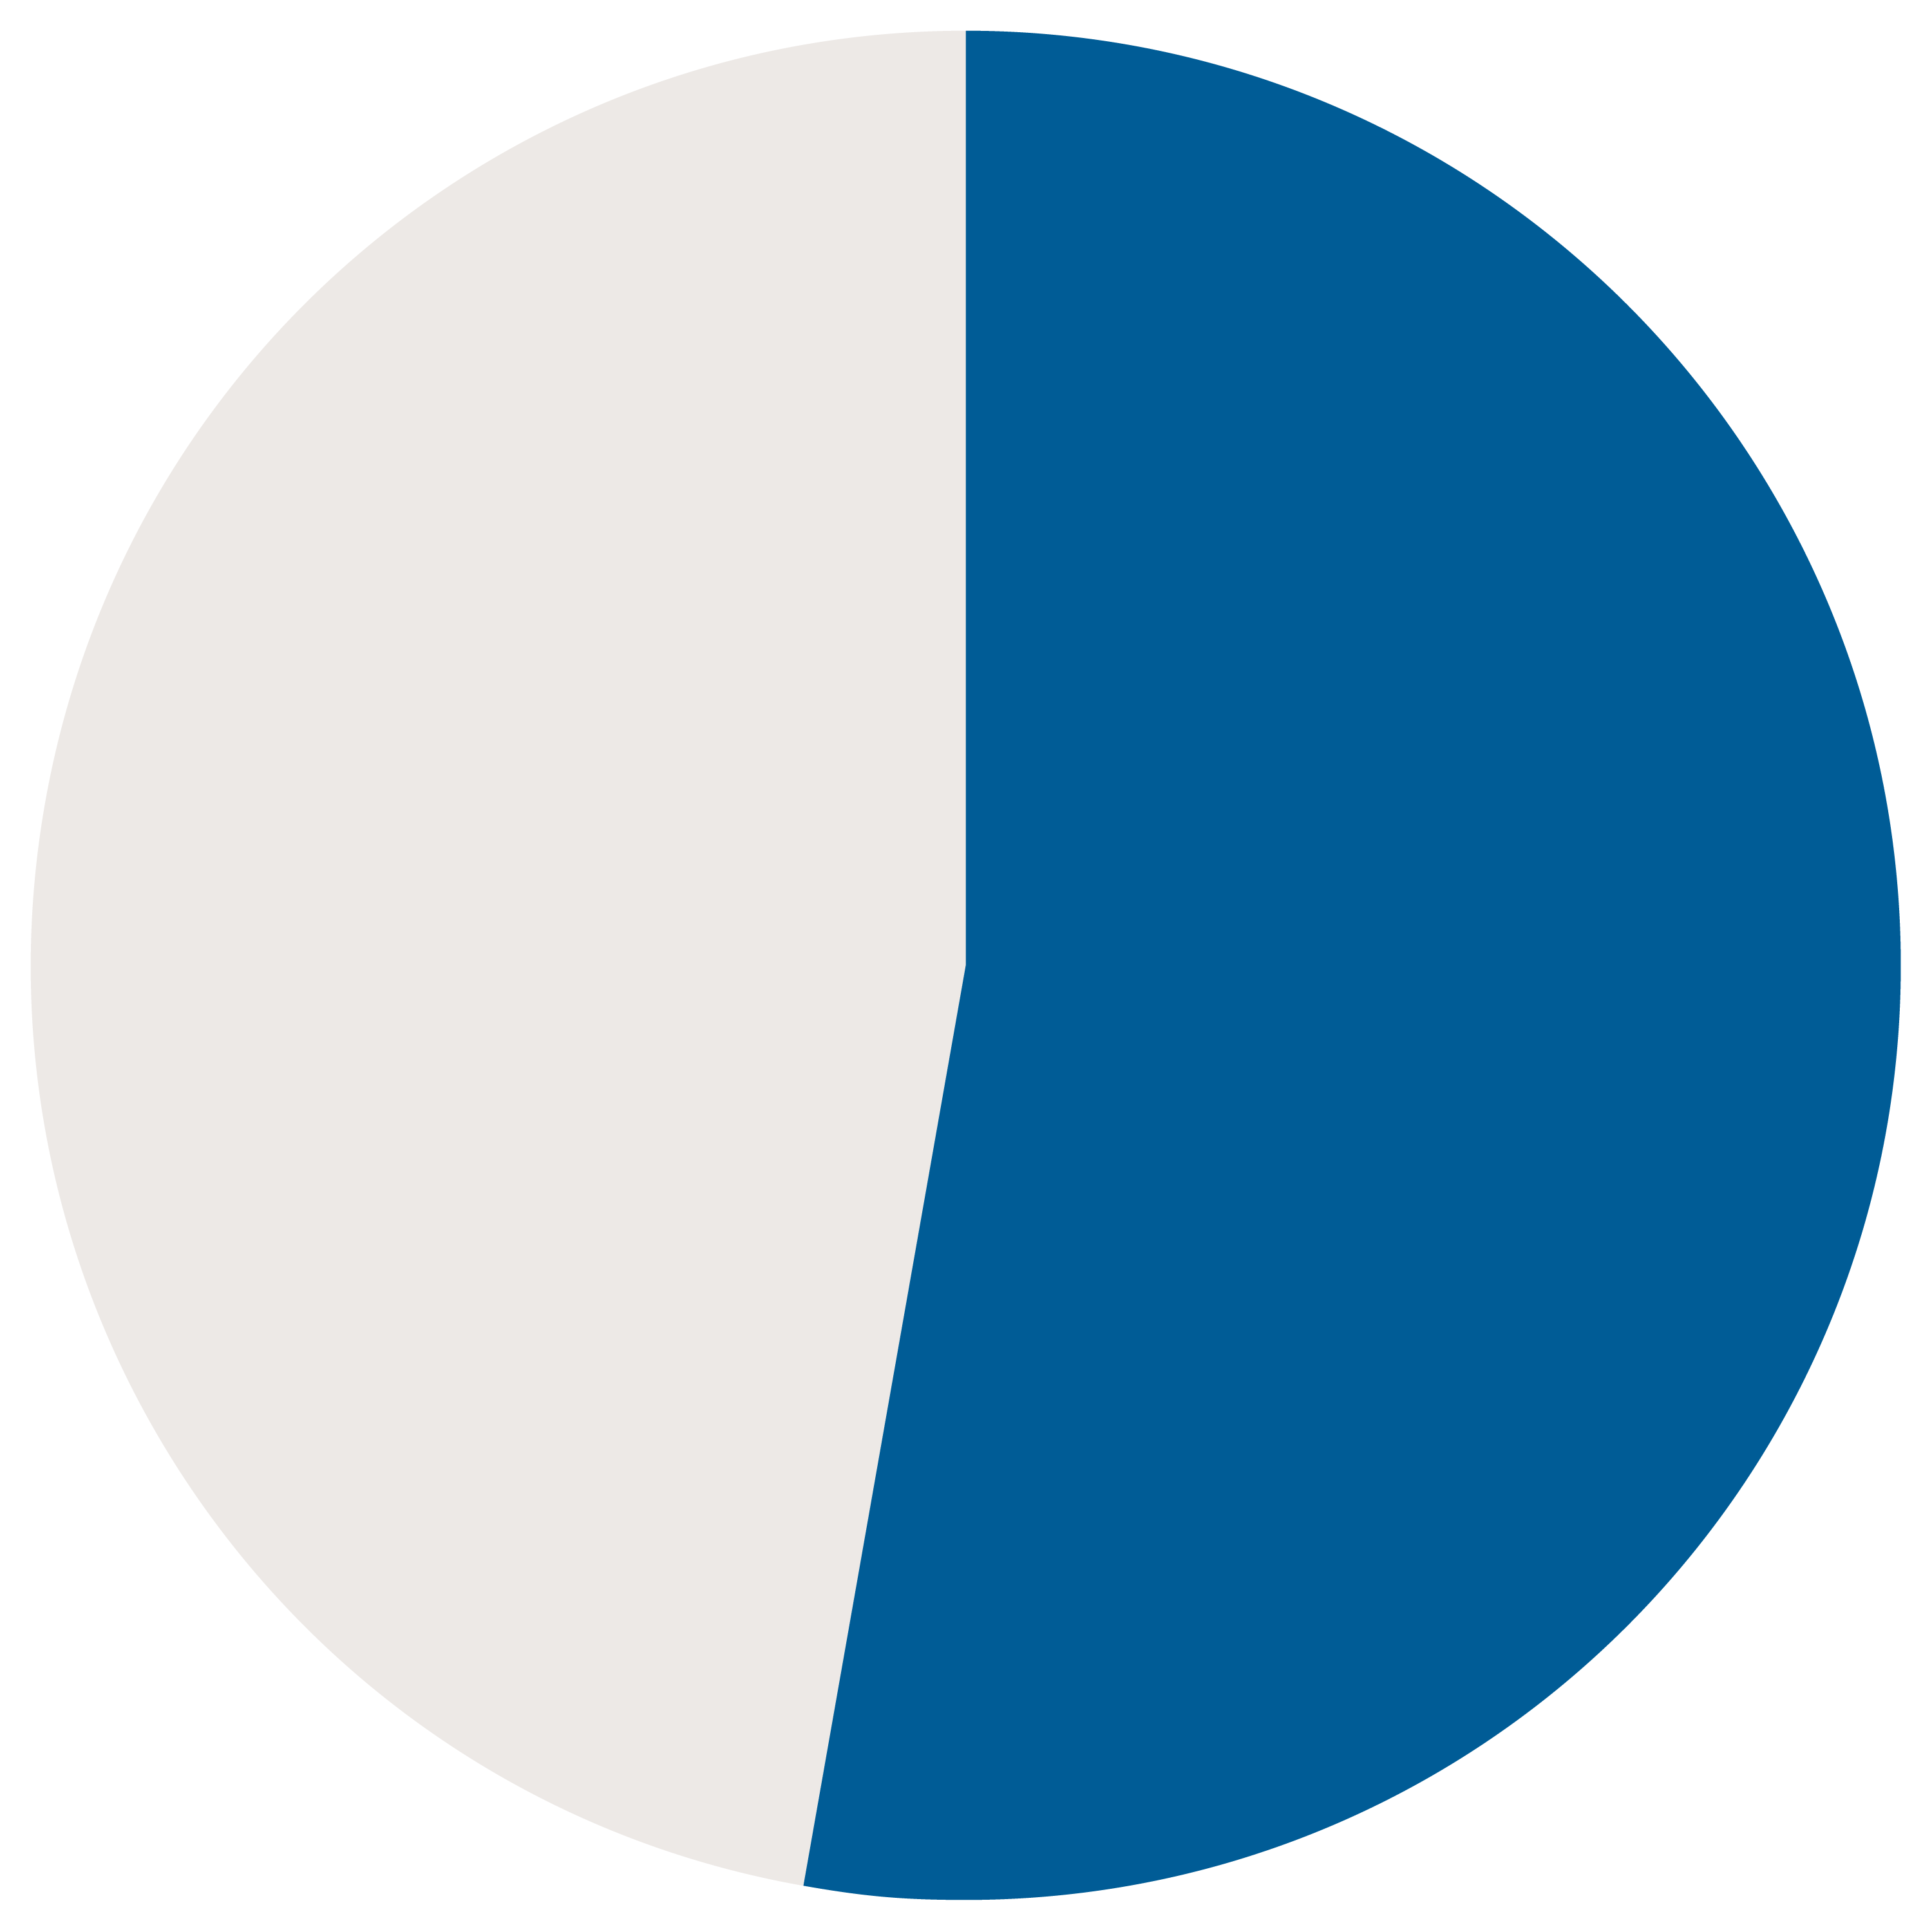
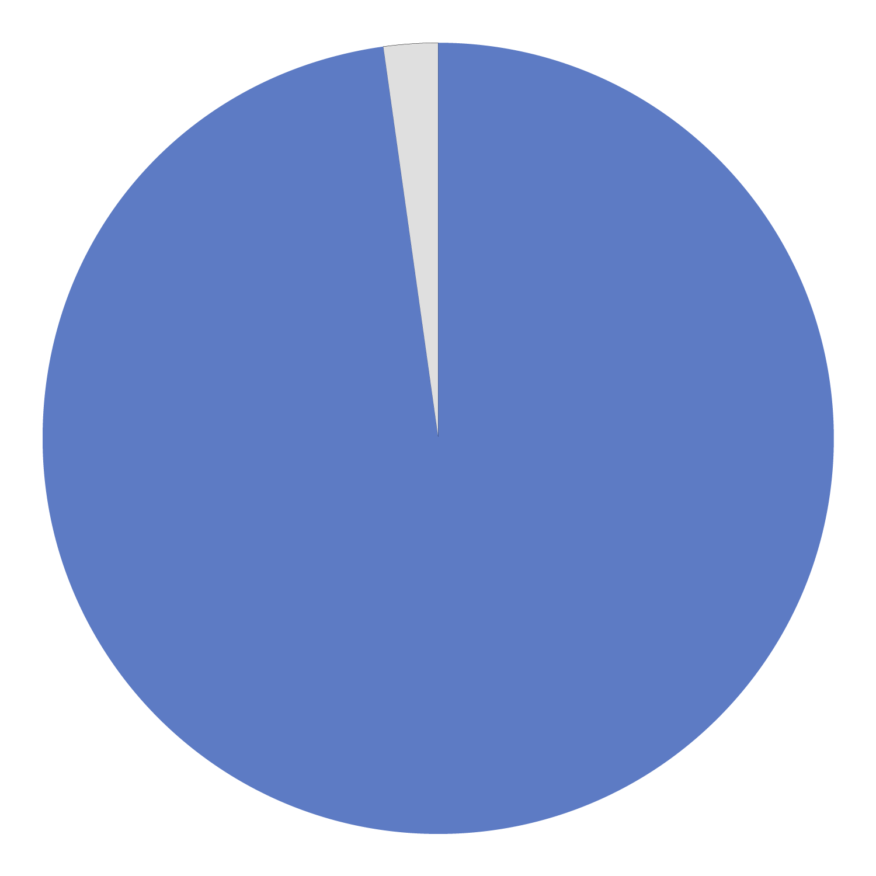
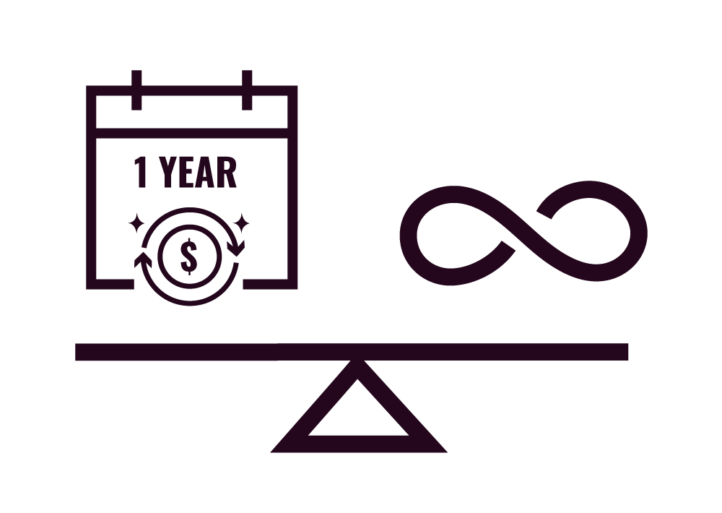
PRIVATE COVERAGE:
2024 Manulife Claims Data²
One of the fastest growing benefits.
But still not enough.
Use of fertility drugs up 26% since 2020
> 1% of clients offer coverage for fertility clinic treatments as part of their plan
A study of Canadian employee benefits plans¹:
25%
Increase in the number of employers offering fertility benefits since 2021
Majority of
employers
do not provide
fertility benefits
98%
Only cover the
cost of drugs
50%
53%
Now offer a lifetime maximum (vs annual)
Median coverage is
$6,000
1.Mapol Research. 2023.
2.Manulife Aggregate Claim data 2024.
Notes:
On the private coverage side, coverage is minimal but growing quickly, but not fast enough.
In 2021 and 2023, Fertility Matters Canada worked with Mapol to research fertility benefits via Canadian employer benefit booklets. The latest data tells us:
The majority of employers are still not including fertility benefits as part of employee benefit plans
Those that do, most (98%) only cover the cost of drugs – not treatment
And the average coverage is $6,000
On the positive side of things, between 2021 and 2023 we have seen a 25% increase in the number of employers offering these benefits and many more now over a lifetime maximum versus an annual maxmium (as most people will need multiple interventions in a year).
If we want to minimize out of pocket costs for families, we need to do better, together.
Manulife has started sharing a little bit of data on their usage which shows the use of fertility drugs is up 26% subce 2020. And in line with the findings shared earlier only 1% of their clients cover treatment. Most only cover the cost of drugs.

Slide 13
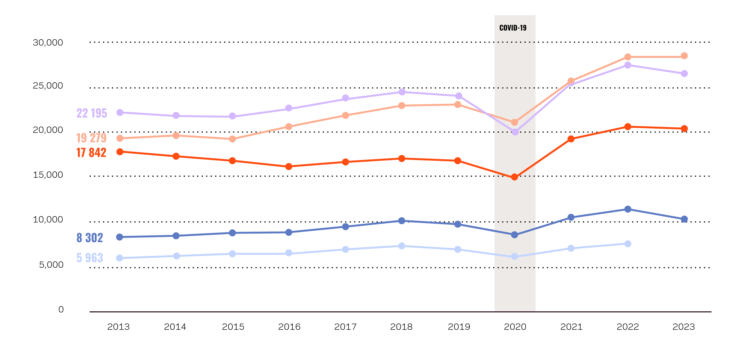
FERTILITY TREATMENT IN CANADA
Are steadily increasing
IVF
IVF Treatment
continues to increase despite costs
28,475
26,525
90%
20,476
increase in egg freezing over the past decades
10,318
2x
7,609
number of surrogacies
2013
2023
Patients
Retrievals
Embryo transfers
Ongoing pregnancy
Live births
1 Canadian Assisted Reproductive Technologies Register (CARTR) Data 2023
Notes:
To give you a sense of the numbers, here’s CFAS data from the past decade that shows fertility treatment in Canada is steadily increasing.
-Obviously we see a dip during the pandemic when many people couldn’t access treatment and then a steady increase with a slow in 2023 alongside economic slowdowns.
What else is interesting is we have seen a 90% increase in egg freezing over the past two decades. This speaks to the growing demand for fertility preservation.
And also at least 2 times as many surrogacies.

Slide 14
PATIENT JOURNEY
Sophia
Sophia is 34. She is single and wants to be a parent. She always imagined she would have had children by this point but expected she would do it with a partner. She worked hard to progress in her career and holds a leadership role at her company (one of only a few women). She feels this focus on work has impacted her personal life. Sophia’s employer covers 80% of her fertility medication up to $5,000 per lifetime.
TREATMENT OPTIONS | TREATMENTS/ DRUGS | OUT OF POCKET COST | EMPLOYER BENEFITS | PUBLIC FUNDING
 |  |  |  | ONTARIO | BC | NOVA SCOTIA
Freeze eggs now for future use | Egg retrieval and freezing Medications Storage | $6,500 $5,500 $500/year | $6,500 $1000 $500/year | $8,000 Does not cover egg freezing | $8,000 Does not cover egg freezing | $4,800 (40% tax credit after insurance )
TOTAL COSTS |  | $12,500 | $8,000 | $8,000 | $8,000 | $4,800
OPTION A
Notes:
Let’s look a few examples of possible patient journeys and what it might cost them in different provinces. It really reinforces how where you live truly shapes your experience and costs.
Meet Sophia. She is 34, single, and wants to be a parent. She always imagined she would have had children by this point in her life but expected she would do it with a partner.
She worked hard to progress in her career and holds a leadership role at her company (one of only a few women). She feels this focus on work has impacted her personal life.
Sophia’s employer covers 80% of her fertility medication up to $5,000 per lifetime.
Treatment option 1 – she can freeze her eggs now for future use, recognizing she is 34 and her ovarian reserve is already dwindling so this may not be a great option for future conception depending on the quality and quantity of her eggs. But this gives her more time to find a partner to fertilize these eggs.
In this scenario – she will pay for her egg retrieval and freezing, medications to stimulate more eggs, and annual storage fees totaling about $12,500. She is lucky to have some private coverage for drugs which brings her costs to $8,000. Now if she lived in Ontario or BC, the price is the same because the these provinces do not cover egg freezing. If she lived in Nova Scotia, she would get a 40% tax credit after insurance so the treatment would cost about $4,800.

Slide 15
PATIENT JOURNEY
Sophia
Sophia is 34. She is single and wants to be a parent. She always imagined she would have had children by this point but expected she would do it with a partner. She worked hard to progress in her career and holds a leadership role at her company (one of only a few women). She feels this focus on work has impacted her personal life. Sophia’s employer covers 80% of her fertility medication up to $5,000 per lifetime.
TREATMENT OPTIONS | TREATMENTS/ DRUGS | OUT OF POCKET COST | EMPLOYER BENEFITS | PUBLIC FUNDING
 |  |  |  | ONTARIO | BC | NOVA SCOTIA
Conceive now with donor sperm via IUI | Donor sperm IUI Medications | $1,000 $650 $1,000 $2,650 | $1,000 $650 $200 $1,850 | $1,000 $650 $200 $1,200 | $1,000 $650 $200 $1,850 | $1,110
Conceive now with donor sperm via IVF (if IUI – option 2 does not work) | Donor sperm IVF Medications | $1,000 $8,000 $8,000 $17,000 (+costs pf IUI) | $1,000 $8,000 $4,000 $13,000 | $1,000 $8,000 $4,000 $5,000 | $1,000 $8,000 $4,000 $5,000 | $7,800
TOTAL COSTS |  | $19,650 | $14,850 | $6,200 | $6,850 | $8,910
OPTION B
Notes:
Her second option is to conceive now via donor sperm.
As IUI is much cheaper than IVF – Sophia would likely start there. The total costs are about $2,650 with the cost of donor sperm, IUI and medications. With her private insurance, about 80% of her drugs are covered. In Ontario, the IUI would be funded and she has 80% drug coverage so her costs would be about $1200. In BC, public funding does not cover IUI so she would still pay $1850 and with Nova Scotia’s tax credit it would cost her about $1110.
We assume in this scenario that the IUI doesn’t work so she moves onto IVF, a more effective option at about 30% conception success rate. In this instance, the costs would be about $17,000 – minus her drug coverage which would reduce her drug costs to $4,000 so about $13,000 total.
In Ontario and BC, the treatment would be covered, so her costs would reduce to about 5,000. And, in Nova Scotia her 40% tax credit after insurance would leave her about $7,800 out of pocket.
We than add the IUI and IVF totals for her total costs. As you can see quite a spread between provinces.

Slide 16
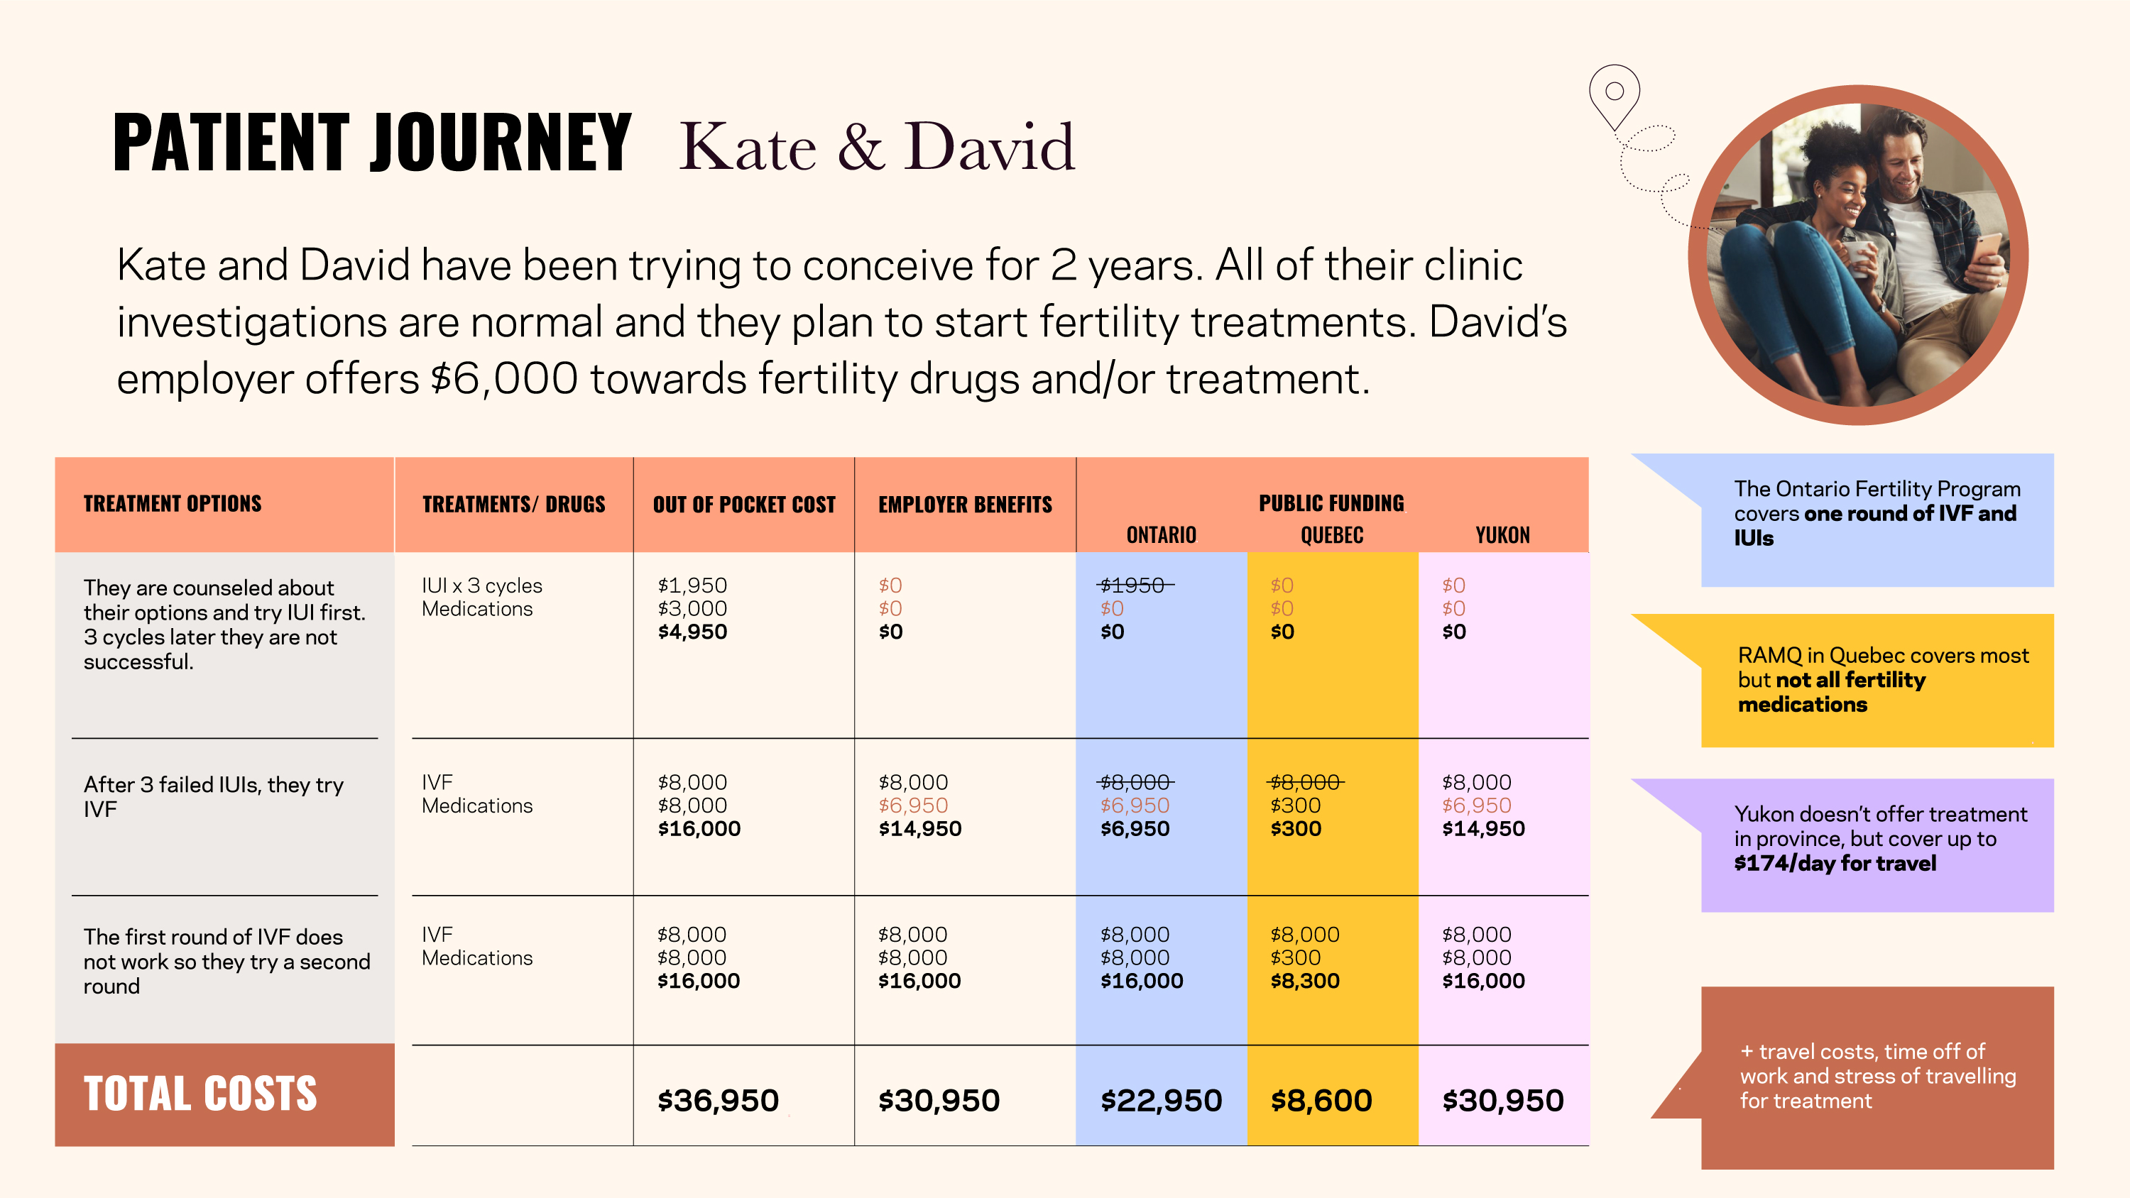
PATIENT JOURNEY
Marina & Susan
Marina and Susan have been trying to conceive with a known donor and home insemination for 7 months without success. They want to explore fertility treatment options at a fertility clinic. Marina’s employer plan does not include fertility benefits and Susan is self-employed with no private insurance
TREATMENT OPTIONS | TREATMENTS/ DRUGS | OUT OF POCKET COST | EMPLOYER BENEFITS | PUBLIC FUNDING
 |  |  |  | ONTARIO | MANITOBA | NEW BRUNSWICK
Conceive with donor sperm via IVF | Donor sperm IVF Medications Counselling Genetic Testing Storage fees | $1,000 $12,000 $6,000 $250 $4,000 $500/year | $1,000 $12,000 $6,000 $250 $4,000 $500/year | $1,000 $12,000 $6,000 $250 $4,000 $500/year | (40% tax credit up to $16,000) Tax credit covers $9,500 | (40% tax credit up to $8,000) Tax credit covers max of $8,000
TOTAL COSTS |  | $23,750 | $23,750 | $11,750 | $14,259 | $15,750
Notes:
In this scenario, Marina and Susan have been trying to conceive with a known donor and home insemination for 7 months without success. They want to explore fertility treatment options at a fertility clinic.
Marina’s employer plan does not include fertility benefits and Susan is self-employed with no private insurance.
They are advised to try IVF using donor sperm. The costs are over $23,000.
If they lived in Ontario, public funding would cover the costs of their first IVF cycle - leaving them with almost $12,000 in costs.
In Manitoba, a tax credit would cover about $9,500 and in New Brunswick the tax credit covers a maximum of $8,000 leaving them with almost $16,000 in costs.

Slide 17
PATIENT JOURNEY
Kate & David
Kate and David have been trying to conceive for 2 years. All of their clinic investigations are normal and they plan to start fertility treatments. David’s employer offers $6,000 towards fertility drugs and/or treatment.
TREATMENT OPTIONS | TREATMENTS/ DRUGS | OUT OF POCKET COST | EMPLOYER BENEFITS | PUBLIC FUNDING
 |  |  |  | ONTARIO | QUEBEC | YUKON
They are counseled about their options and try IUI first. 3 cycles later they are not successful. | IUI x 3 cycles Medications | $1,950 $3,000 $4,950 | $0 $0 $0 | $1950 $0 $0 | $0 $0 $0 | $0 $0 $0
After 3 failed IUIs, they try IVF | IVF Medications | $8,000 $8,000 $16,000 | $8,000 $6,950 $14,950 | $8,000 $6,950 $6,950 | $8,000 $300 $300 | $8,000 $6,950 $14,950
The first round of IVF does not work so they try a second round | IVF Medications | $8,000 $8,000 $16,000 | $8,000 $8,000 $16,000 | $8,000 $8,000 $16,000 | $8,000 $300 $8,300 | $8,000 $8,000 $16,000
TOTAL COSTS |  | $36,950 | $30,950 | $22,950 | $8,600 | $30,950
The Ontario Fertility Program covers one round of IVF and IUIs
RAMQ in Quebec covers most but not all fertility medications
Yukon doesn’t offer treatment in province, but cover up to $174/day for travel
+ travel costs, time off of work and stress of travelling for treatment
Notes:
Now meet Kate and David have been trying to conceive for 2 years. All of their clinic investigations are normal and they plan to start fertility treatments. David’s employer offers $6,000 towards fertility drugs and/or treatment.
They are counseled about their options and try IUI first. 3 cycles later they are not successful. David’s benefits cover the all the costs with $1,050 remaining in benefits. They use this towards a cycle of IVF but are not successful they try a second round of IVF. After two IVF attempts their costs after benefits are over $30,000.
If they lived in Ontario, the first IVF cycle would be funded and cost them almost $23,000.
In Quebec, their first IVF round is covered and most of the drugs for both rounds of IVF leaving with about $8,600 in costs.
In the Yukon, there is no funding so they are left with over $30,000 in costs, plus the costs to travel out of province for treatment.

Slide 18
PATIENT JOURNEY
Megan & Steve
Steve has a family history of Huntington’s disease and was recently found to carry the gene. Megan and Steve want to conceive but they are worried about passing this disease onto their children. They have tried and failed their first IVF cycle. Megan’s employer offers $10,000 in fertility drugs and Steve’s employer covers $5,000 in fertility drugs.
TREATMENT OPTIONS | TREATMENTS/ DRUGS | OUT OF POCKET COST | EMPLOYER BENEFITS | PUBLIC FUNDING
 |  |  |  | ONTARIO | ALBERTA | PEI
IVF | IVF Medications | $8,000 $8,000 $16,000 | $8,000 $0 $8,000 | $8,000 $0 $0 | $8,000 | $8,000 $0 $0
IVF + PGT (paternal genetic testing) | IVF Medications Genetic Testing | $8,000 $8,000 $4,000 $20,000 | $8,000 $1,000 $4,000 $13,000 | $8,000 $1,000 $4,000 $13,000 | $13,000 | $6,000 $1,000 $4,000 $11,000
TOTAL COSTS |  | $36,000 | $21,000 | $21,000 | $21,000 | $11,000
There are no clinics in PEI so they would need to travel out of province (and incur additional costs). And, if they delay treatment a year, they would be reimbursed another $10,000.
Notes:
Finally meet Megan and Steve. Steve has a family history of Huntington’s disease and was recently found to carry the gene. They want to conceive but they are worried about passing this disease onto their children. They have tried and failed their first IVF cycle.
Megan’s employer offers $10,000 in fertility drugs and Steve’s employer covers $5,000 in fertility drugs.
After using their benefits, if they lived in Ontario they would still pay about $21,000. In Alberta, it would be $21,000 and in PEI with their reimbursement program they would pay $11,000 and have to travel out of province for treatment. If they wanted until they next calendar year for their second round of IVF, they could be reimbursed another $10,000.

Slide 19
WHY THIS MATTERS
FOR EMPLOYERS?
Attract & retain talent
Reduce costs associated with
sick leave and resignations
42%
of employees say lack of fertility benefits is a deal breaker when accepting a new job¹.
Improved well-being and mental health
65%
would change jobs to work for company with fertility benefits
Increased productivity and engagement
75%
consider these benefits an important part of an inclusive company culture.
Reinforces a company’s values
Plus, YOU stand out for thoughtful benefit management
1 Carrot Fertility survey. 2023
Notes:
As you can see, even with public funding, people are still left with huge expenses and employers can help bridge this gap.
For employers, what we often hear is that this is usually a values based decision. They see it as the right thing to do for their people. That said, it’s also a good business decision.
Research shows that offering fertility benefits helps attract and retain talent. It reduces costs associated with employees taking sick leave or resigning because they don’t feel supported. And overall, they feel more supported and engaged at work.
In fact 42% say that a lack of fertility benefits is a deal break when it comes to accepting a new job.
65% would change jobs to work for a company with fertility benefits – and I see this all the time. If you join any online fertility support groups there are soooo many people who give up jobs to work at Starbucks because they have great fertility benefits.

Slide 20
ACCORDING TO WOMEN
UNDERGOING IVF:
For many, undergoing fertility treatment is one of the most stressful events of one’s life.
Most (58%) hide they are going through IVF
for fear of losing their job
One in 10 (12%) quit their job due
to lack of support
Of the women who told employers, 64%
said it made their overall IVF experience easier
Zurich Insurance. UK IVF Poll 2022.
Notes:
As we know, its women or people with uterus’ that typically bear the brunt of treatment and its grueling. Research shows its one of the most stressful events of one’s life.
Most women (58%) hide going through treatment for fear of losing their job.
One of 10 quit because of the lack of support
Yet a bright spot – of the women who told their employer they were going through treatment – 64% said it made the experience easier.

Slide 21
INFERTILITY TAKES A HEAVY TOLL
ON MENTAL HEALTH
While pregnancy and childbirth are celebrated and highly visible, fertility challenges are often invisible and silent.
40% of women are diagnosed with depression and/or anxiety while undergoing fertility treatment.
Treatment is stressful which can result in poor performance and low engagement.
Unable to share/confide in others, particularly employer for privacy, fear of losing job, or missed promotions/opportunities at work.
Forced to miss work for time-consuming and unpredictable appointments, which can add to workload and stress.
Fertility medications including hormone therapy can affect one’s mental state and mood, interrupt sleep, cause anxiety, depression, and other symptoms.
Human Resources and/or Managers are often not equipped to help. They don’t know what to say or how to help.
Notes:
And that support is important because infertility takes a heavy toll on one’s mental health - another growing space for benefits.
40% of women are diagnosed with depression or anxiety while going through treatment.
While we celebrate pregnancy and birth, trying to conceive is often hidden. At work, people may worry disclosing may result in missing a promotion, not being included in priority projects or even job loss.
This is exacerbated because during treatment, people are forced to take time off for time consuming and unpredictable appointments which add to stress and workload. They may also be on medications which affect sleep and mood.
These stresses can result in diminished productivity and low engagement in the office which adds more stress onto patients.
And most often managers and HR teams are not equipped to help. They aren’t always aware of what to say or how to help - even when a company offers these benefits.

Slide 22
FERTILITY BENEFITS DO NOT NEED TO INCREASE COSTS
A Mercer report found coverage is growing
Biggest perceived barrier was that IVF coverage leads to high-cost claims
97% reported it has not resulted in a significant increase in plan costs
Median benefit maximum $16,250
22% use a specialty vendor to administer these benefits
Notes:
Some advisors or plan sponsors assume that this benefit may be out of reach because they are too expensive with the high cost of treatment and low use among employees.
But, fertility benefits don’t need to increase costs.
Since 2019, Mercer has started sharing their plan data:
As you can see – coverage is growing steadily over time.
The biggest barriers to coverage was the price tag and perception that IVF coverage leads to high-cost claims
The reality is 97% of employers reported it has not resulted in a significant increase in plan costs (recognizing that most of these number are from medium and large employers). We don’t have any Canadian data yet but we are working on it.
In addition, it’s interesting to note that 12% are using a specialty vendor to administer these benefits.

Slide 23
INSURANCE OPTIONS (AS OF DEC 24)
* Total amount across services/products
 | AMOUNT OF COVERAGE
 | DRUGS | TREATMENT | SURROGACY / ADOPTION | NOTES
ALBERTA BLUE CROSS | $10,000 |  |  | Lifetime max
BENEPLAN | $2,500* | $2,500* |  | Lifetime max
CANADA LIFE |  |  |  | Included in drug maximum. Additional coverage available
DESJARDINS | $5,000* | $5,000* |  | Min 10 employees - $5,000 for drugs AND treatment
EMPIRE LIFE | $15,000* | $15,000* |  | Lifetime max
MANULIFE | $15,000 |  |  | Lifetime max
MEDAVIE BLUE CROSS (MBC) - ESSENTIAL | $5,000 | $5,000 | $10,000 each
MBC - ENHANCED | $10,000 | $10,000 | $30,000
MBC - PREMIER | $15,000 | $15,000 | $30,000
SUNLIFE - SUNADVANTAGE | $2,400 |  |  | Offers an add-on for surrogacy and adoptions
SUNLIFE - SUNSOLUATIONS | $50,000* | $50,000* | $50,000*
Notes:
Today, pretty much every insurance carrier provides fertility benefits and they are updating their solutions all the time. Here’s a snap shot of some current offerings.
What’s important to note is often carriers divide support by drugs, treatment and surrogacy/adoption coverage so ask questions to understand the options and now what your clients need and want.

Slide 24
SPECIALTY VENDORS THAT CAN SUPPORT
 | ABOUT | SERVICES | GROUP SIZE | MODEL | COST
CARROT FERTILITY | Benefits management Personalized care for fertility and family building journeys | Personalized care plans for the fertility/family building Provide access to clinics and doctors Financial planning and credit cards Employee support Content and education | 500 | Reimburse members for care with the overall budget set by the employer | PEPM
PROGYNY | Benefits management | Provide access to clinics and doctors Offers financial planning Content and education | 250 | Reimburse members for care with the overall budget set by the employer | PEPM
MY STORIA (Canadian, women-led startup) | Fertility platform that helps people navigate their family building journey and simplifies benefits implementation to help patients manage costs and care. | Concierge support with fertility team Secure record organization Tailored education resources Financial advocacy | NA | Platform fee and optional concierge add-on packages | PEPM OR PPU
SPROUT FAMILY (Canadian, women-led startup) | Benefits management and personalize virtual care for fertility and family building journeys | Unlimited virtual appointments with specialists Partner network with exclusive negotiated treatment rates Personalized educational resources Budgeting support and benefits administration | NA | Platform fee for digital health access ASO benefit for employee coverage through Sprout Pay | PEPM for platform Admin fee for benefits administration
Notes:
In addition, the types of support are also expanding. In recent years, many new companies have launched fertility offerings to complement traditional benefits. These companies help fill the education gap that exists for most by providing coaching, advice and personalized support that is often missing during a fertility journey.
In Canada, the following are available:
Carrot, Progyny, and Sprout Family are benefits management companies offering personalized care plans, education and financial planning. Sprout Family is also a Canadian and women-led company curated to the Canadian marketplace.
MyStoria is a record management company that helps patients manage costs and care that is also Canadian and women-led.
For smaller companies that are not ready to offer traditional benefits, these offerings can also be a stepping stone to provide some support in lieu of drug or treatment coverage. The costs are typically per employee, per month.

Slide 25
PLAN DESIGN IS KEY
Suggested guidelines
Cover drugs + treatment
Limit on dollar benefit
Limit lifetime dollar (not annual)
Limit number of IVF cycles
Consider age caps over 45 years old
Minimum one year tenure before fertility benefits apply
Notes:
So What now – you need to know that plan design is key to managing costs. Here are recommendations we have developed with fertility benefit experts to maximize support for employees and value for dollars.
Cover drugs plus treatment (not only drugs which is current majority of plans). This could even be defined as any service provided by a fertility clinic.
Rather than an annual maximum, set a lifetime maximum so people can do multiple treatments in a year (which is typically required).
In terms of the dollar amount - An ideal amount is $20,000 which covers one round of IVF but that is not possible for all employers. The current median is $6,000.
Limit number of IVF cycles to three to help cap costs.
Consider adding an age cap for people over 45 years old when fertility treatment is unlikely to be successful. Most provincial plans include an age cap.
To ensure employees are not only joining for the benefit, establish a one year tenure before fertility benefits apply. You would be amazed at how many people get a job at Starbucks for the fertility benefits! Fertility community groups are filled with stories like this because people are desperate for support.

Slide 26
Employers
Advisors
Ask your benefits advisor/consultant about fertility benefit options
Begin the conversation with plan sponsors at renewal
Survey your employees about their feelings on fertility benefits and support
You don’t need to be an expert. Just know the facts:
Insurance Carriers
Average workforce age (how many between 20-45)
Low use
Doesn’t need to increase costs
Reinforces your values to employees
Improves retention
Attracts talent
Embed fertility benefits in every plan
Cover the costs for drugs and treatment – not only drugs
HOW TO GET STARTED!
Implement lifetime limits not annual
Remove fertility drugs from the “Lifestyle” category
Notes:
In terms of next steps – a great place to start is at renewal time. Remember you don’t need to be an expert, you just need to know the facts.
Look at your client's book of business – how many employees are under 45 and may benefit from this benefit.
Remember, costs are manageable with smart plan design and can be scaled to increase comfort and it’s a great way for plan sponsors to show value to employees while improving retention and attracting talent.
Employers – can start by asking your benefits advisor about fertility benefit options and talk to your employees. See what they need and want.
And insurance carriers, while anything can be built, we hope they will look to embed some fertility benefits in every plan as an opt out rather than an opt in. They can expand access by making the coverage of drugs and treatment more common, while encouraging lifetime not annual limits.
They can also remove fertility drugs from the ”lifestyle” category alongside anti-cession and viagara because this is a medical condition that requires treatment and there is nothing lifestyle related about it.
Thank you!

Slide 27
Questions?
Want to book an education session with your team?
Contact:
Tara Wood
Co-founder, Fertility Benefits Matter
Tara@purposecommunications.ca
The Healthcare business of Merck KGaA, Darmstadt, Germany operates as EMD Serono in the U.S. and Canada

